Slide 2
Project 2010 Overview
Ignite World Wide Tour
Microsoft Corporation

Slide 3
Agenda
Overview of Project 2010 Investments
Project Server 2010
Project Professional 2010

Slide 4







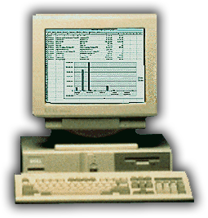




Microsoft Project Evolution From desktop scheduling to project and portfolio management
2010
Financial
Management
Resource
Management
1987
Portfolio
Management
Reporting
Scheduling
Simple reporting
Task management
Print
Resource tracking
Program
Management
Project
Collaboration

Slide 5
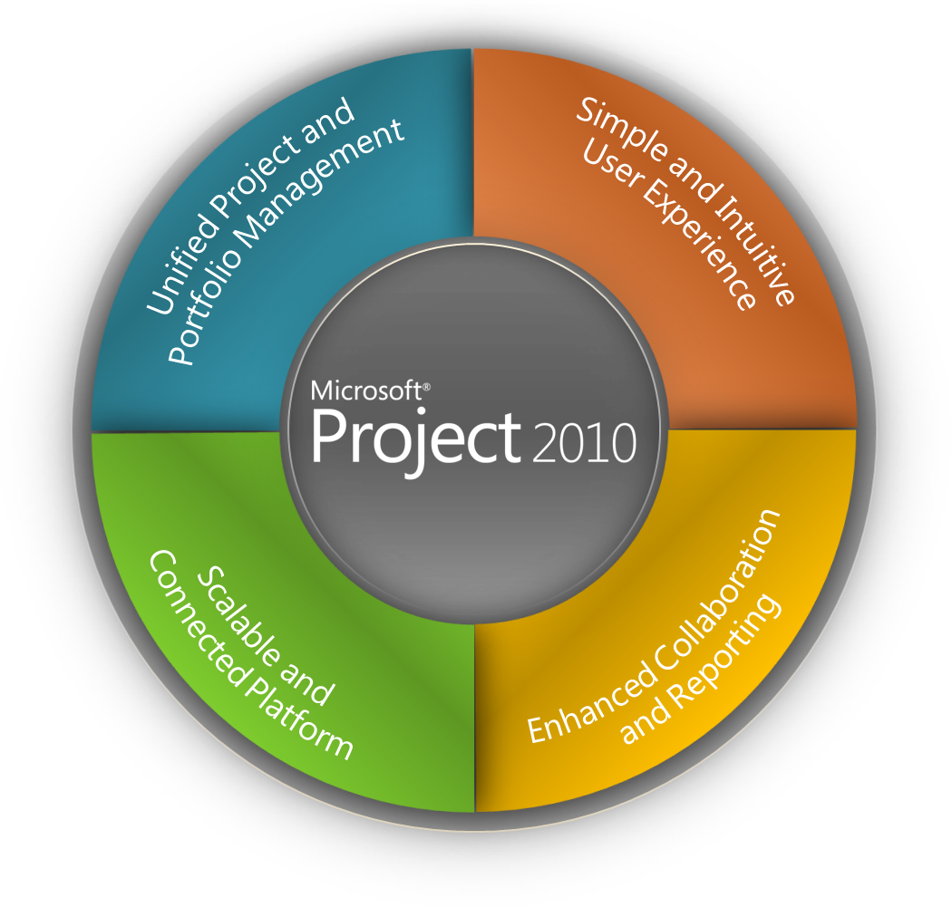
Project 2010 Investment Areas Work Management Solutions for Individuals, Teams and the Enterprise

Slide 6
Choose the Right Tools that Can Evolve with You Work Management Solutions for Individuals, Teams and the Enterprise
IT Mgt · NPD · Cap Projects · Govt
Project & Portfolio Management
Enterprise
Workgroup Collaboration and Reporting
Project Server 2010
(Built on SharePoint® Server)
Level of Collaboration
Team
Project Pro Synch to SharePoint
Web-Based Project Editing (Project Server)
Project Managers
Project Professional
SharePoint Task Lists
Individual
Low
Medium
High
Level of Complexity

Slide 7






Project and Portfolio Management For SharePoint
Demand Management
BI & Reporting
Portfolio Selection
Project Team Collaboration
Resource Management
Schedule Management
Synch to SharePoint
Sites
Composites
Communities
Insights
Content
Search
The Business Collaboration Platform for the Enterprise and the Web

Slide 8
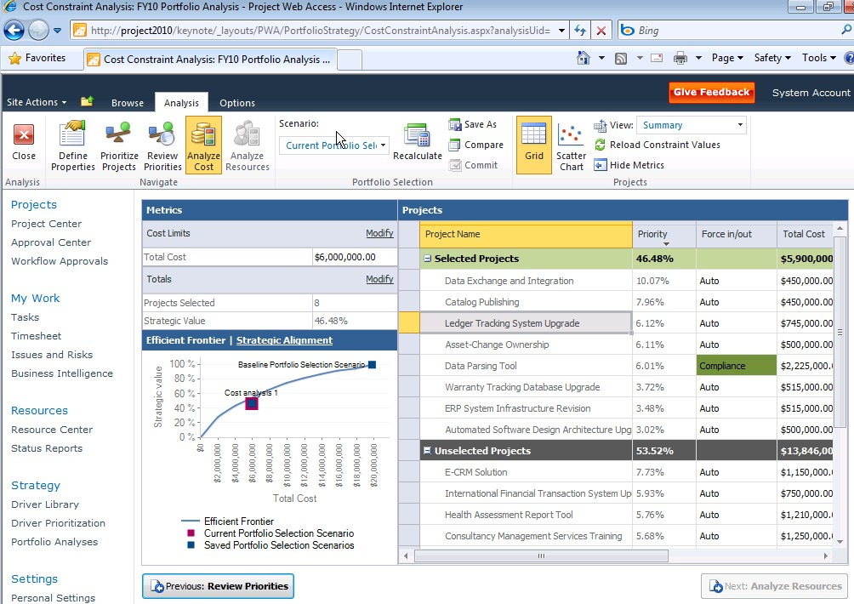

Microsoft Project 2010 Unified Project and Portfolio Management
Single server with end to end PPM capabilities
Flexible project capture and initiation
Enhance governance through workflow
Powerful portfolio selection analytics
Unified Project and Portfolio Management
Simple and Intuitive User Experience
Scalable and Connected Platform
Enhanced Collaboration and Reporting

Slide 9
Unify Project and Portfolio Management Merge top down and bottom up capabilities
Create
Select
Plan
Manage
Top Down
Portfolio Management
Business Case Definition
Demand
Management
Portfolio Prioritization
Portfolio
Reporting
Portfolio
Optimization
Capacity
Planning
Resource
Management
Project
Reporting
Project Scheduling
Time
Reporting
Team Collaboration
Issues and Risk
Management
Bottom Up Project Management
Notes:
Project Server 2010 further integrates the Top Down Portfolio Management capabilities of Project Portfolio Server 2007 with the Bottom Up Project Execution capabilities of Project Server 2007 to provide organizations with a powerful work management solution that supports the entire PPM lifecycle. In addition to the integration of the two servers, Project Server 2010 enhances the overall support of the PPM life cycle by streamlining the demand management from idea creation through successful execution and close-out.
In Project Server 2010 the best of breed portfolio management techniques of Office Project Portfolio Server 2007 are included in Microsoft Project Server 2010, providing a single server with end to end project and portfolio management (PPM) capabilities.
Familiar SharePoint user interface throughout the solution
Common data store eliminating the need for the Project Server Gateway
Intuitive and simplified administration
Comprehensive Application Programming Interface (API) including both project and portfolio capabilities

Slide 10
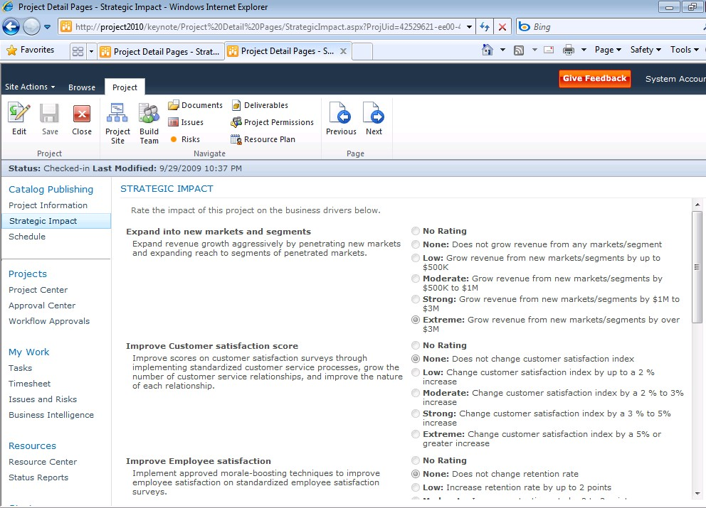





Unified Project and Portfolio Management Capture all work in a central repository
Capture all Requests
Control via Workflow
Build Business Case
IT Project Workflow
Work Request Workflow
Business Project Workflow
Strategic Impact Assessment

Slide 11
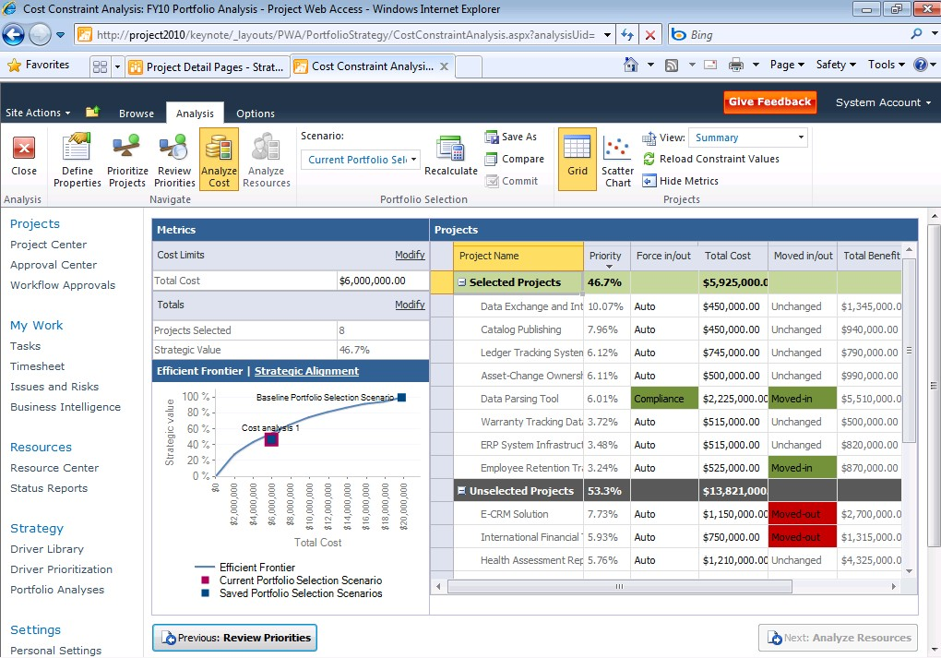
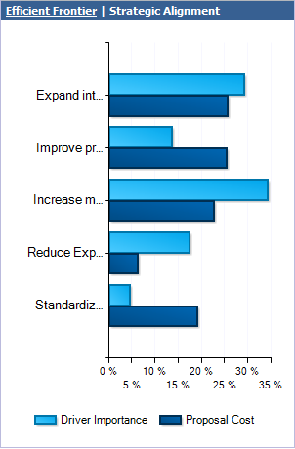
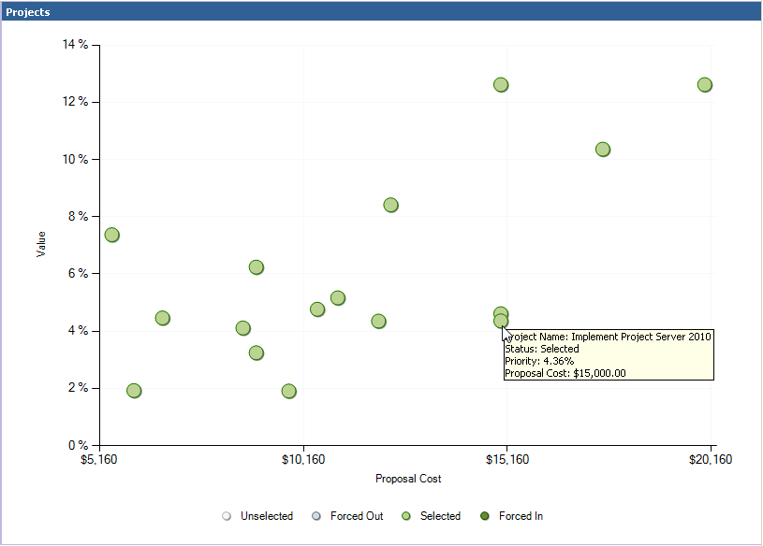
Unified Project and Portfolio Management Select the right projects that align with business strategy
Budget Constraints
Portfolio Prioritization and Optimization
Familiar SharePoint UI and common data store
Intuitively prioritize business drivers
Improved optimization view to enhance decision making
Advanced analytics (e.g., Efficient Frontier) displayed within optimization view
Strategic Alignment
Optimization Analysis
Specify Force In/Out Criteria
Efficient Frontier
Scatter Chart

Slide 12
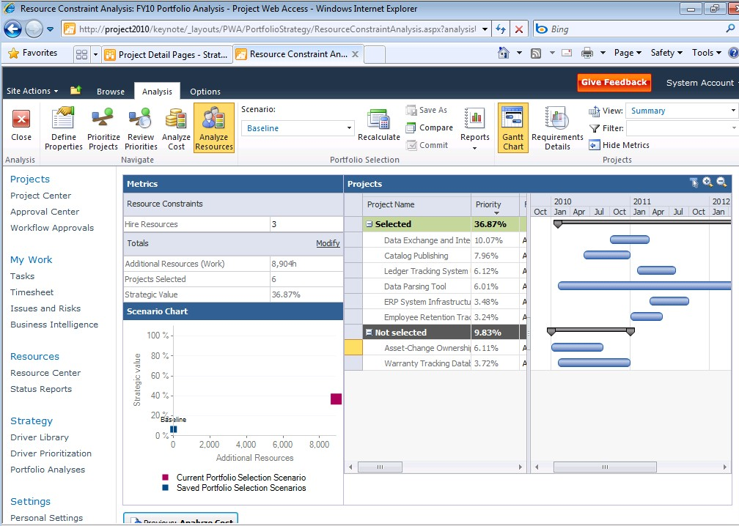
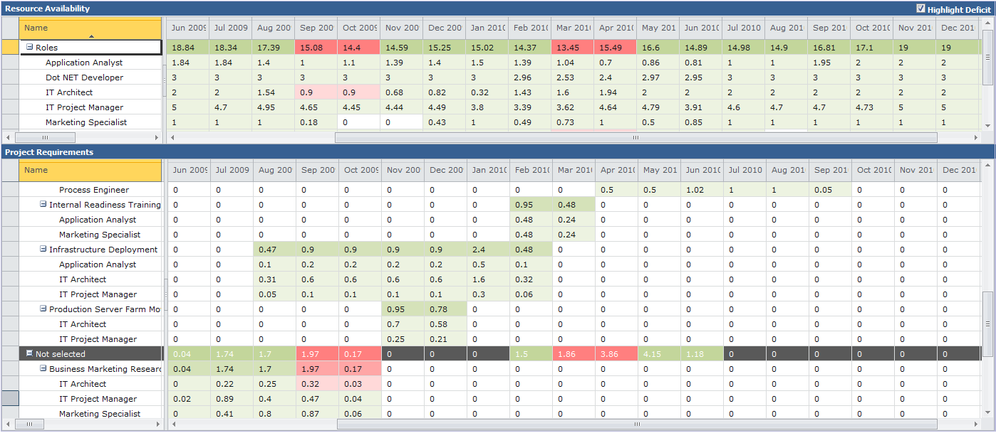
Unified Project and Portfolio Management Maximize resource utilization through capacity planning
New Capacity Planning Module
Assess resource demand versus availability and identify gaps
Adjust project schedules to maximize resource utilization
Model headcount decisions
Finalize and communicate delivery roadmap
Resource Capacity by Skill
Adjust project schedules
Resource Requirements
Deficit Highlighted

Slide 13

Project Initiation and Portfolio Strategy
demo

Slide 14
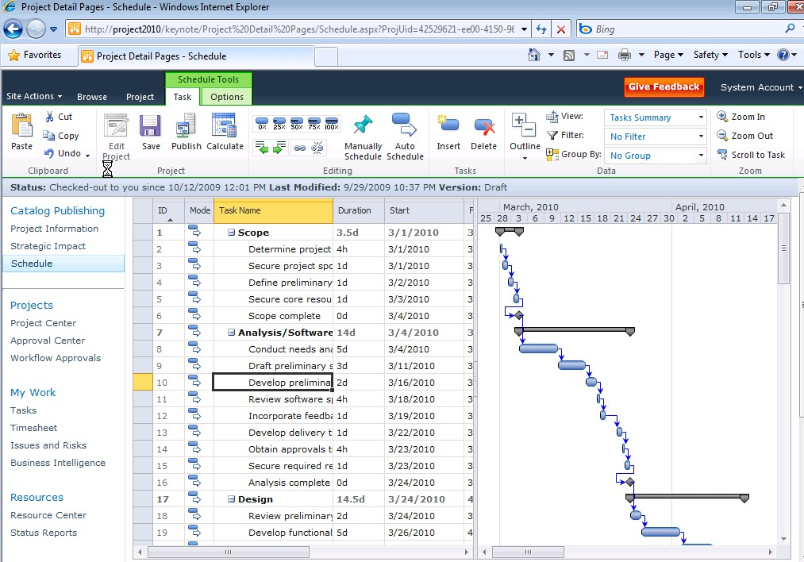
Microsoft Project 2010 Simple and Intuitive User Experience
Ribbon UI and Backstage view
Intuitive Excel-like behavior
Timeline and Team Planner views
Web-based project editing
Unified Project and Portfolio Management
Simple and Intuitive User Experience
Scalable and Connected Platform
Enhanced Collaboration and Reporting

Slide 15
Web-Based Project Editing
demo

Slide 16

Microsoft Project 2010 Enhanced Collaboration and Reporting
Built on SharePoint Server 2010
Connect teams with SharePoint Sync
Better time and status reporting
Easily create reports and dashboards
Sites
Composites
Communities
Insights
Content
Unified Project and Portfolio Management
Simple and Intuitive User Experience
Search
Scalable and Connected Platform
Enhanced Collaboration and Reporting

Slide 17
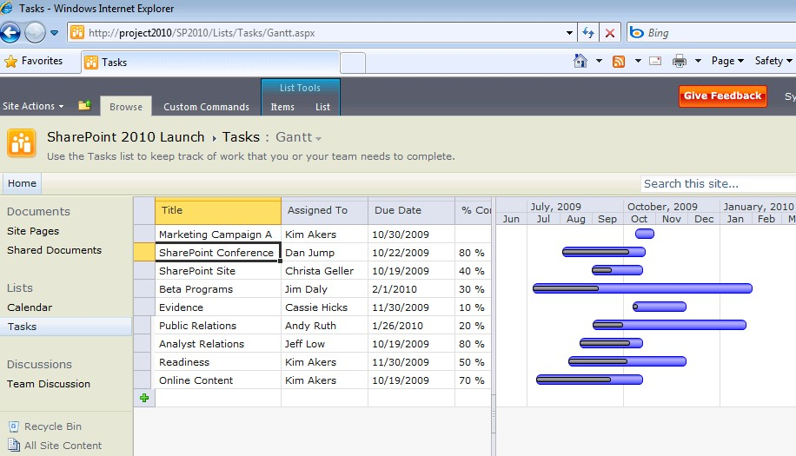
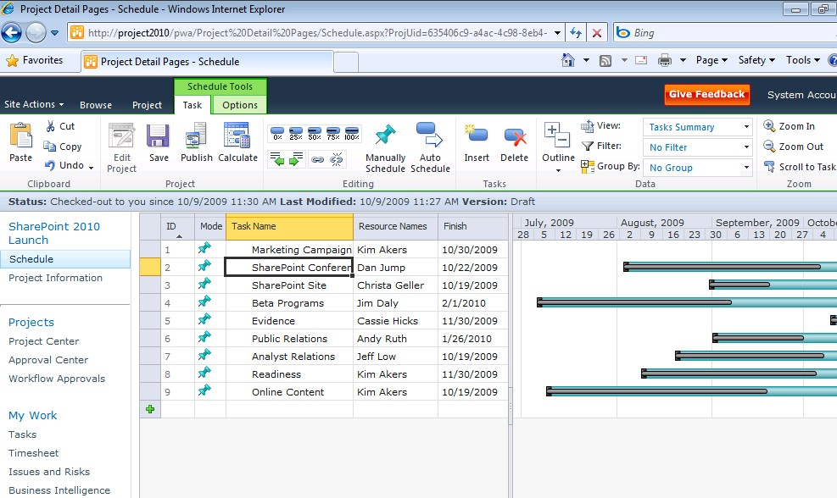
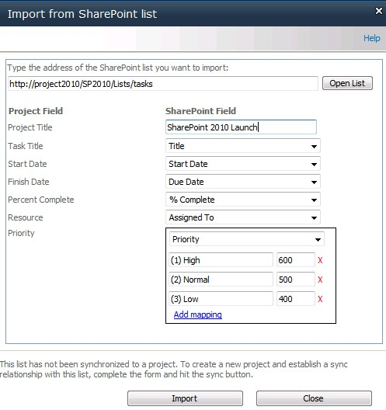
Enhanced Collaboration and Reporting SharePoint Sync to Project Server 2010
SharePoint
Task List
Lightweight collaboration through SharePoint Tasks list
Sync SharePoint Tasks into Project Server to drive enterprise Resource Management and Reporting
Take advantage of richer Project Management capabilities using Project Server
Project Server 2010
Project Plan
Notes:
17

Slide 18
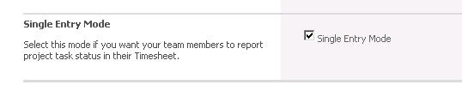
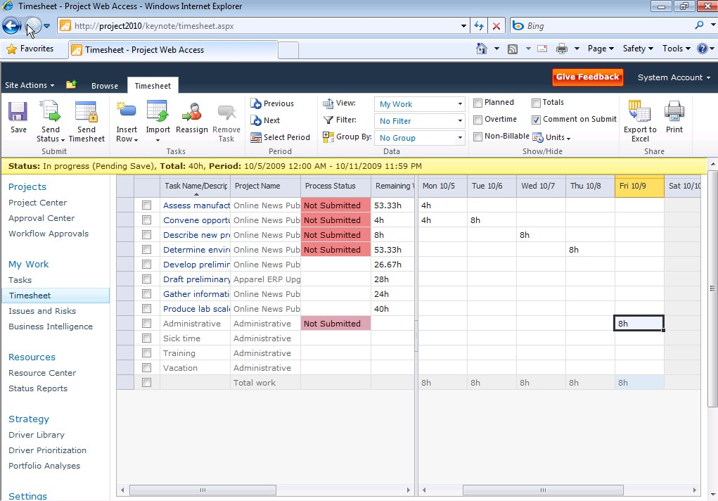
Enhanced Collaboration and Reporting Simplified single entry mode for time reporting and statusing
Improved user experience
Single entry mode to unify timesheet entry and task statusing
Consolidated Approval Center
New User Delegation
Single Entry Mode Option
Improved Timesheet Experience
Notes:
18

Slide 19
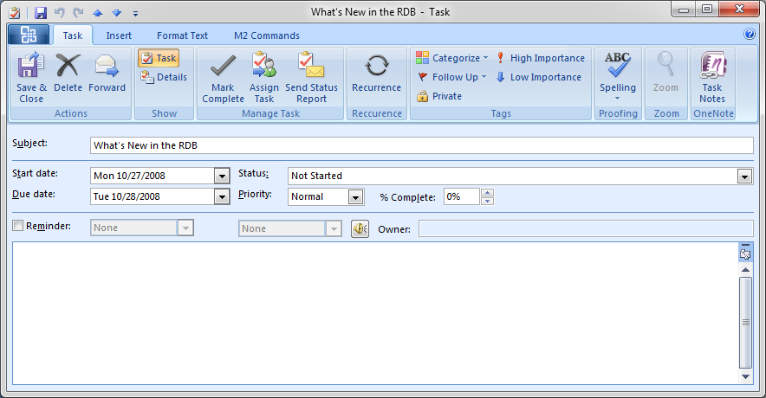
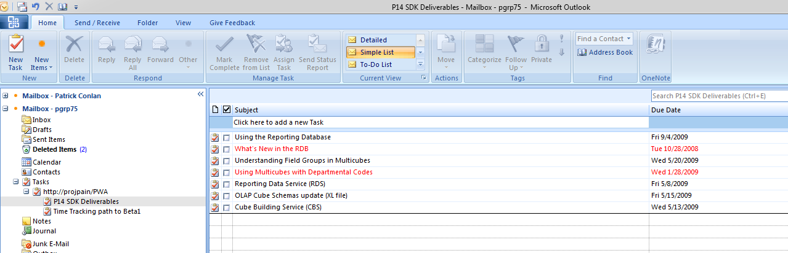


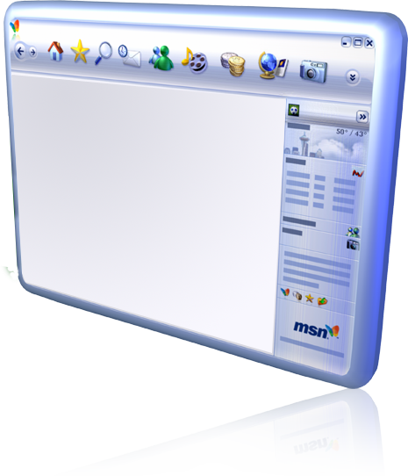

Enhanced Collaboration and Reporting Stay connected through Outlook
Task Details
Exchange Server Integration
Project tasks shown as Outlook tasks grouped by project name
Receive notifications and provide updates through Outlook (% complete, total work, actual work)
Empower the mobile workforce – receive and update tasks on the go
Project Tasks in Outlooks

Slide 20






Enhanced Collaboration & Reporting Take advantage of the Microsoft Business Intelligence Platform
Personal BI
Department BI
Enterprise BI
Business Intelligence Center
Excel Services
Personal BI for Team Members, PMs, and Power Users
Departmental BI for effective team collaboration and communications
Enterprise BI for standard reporting and metrics
PerformancePoint Services
Visio Services
SQL Server Reporting Services
SQL 2008 R2: Self Services BI, PowerPivot
Notes:
20

Slide 21
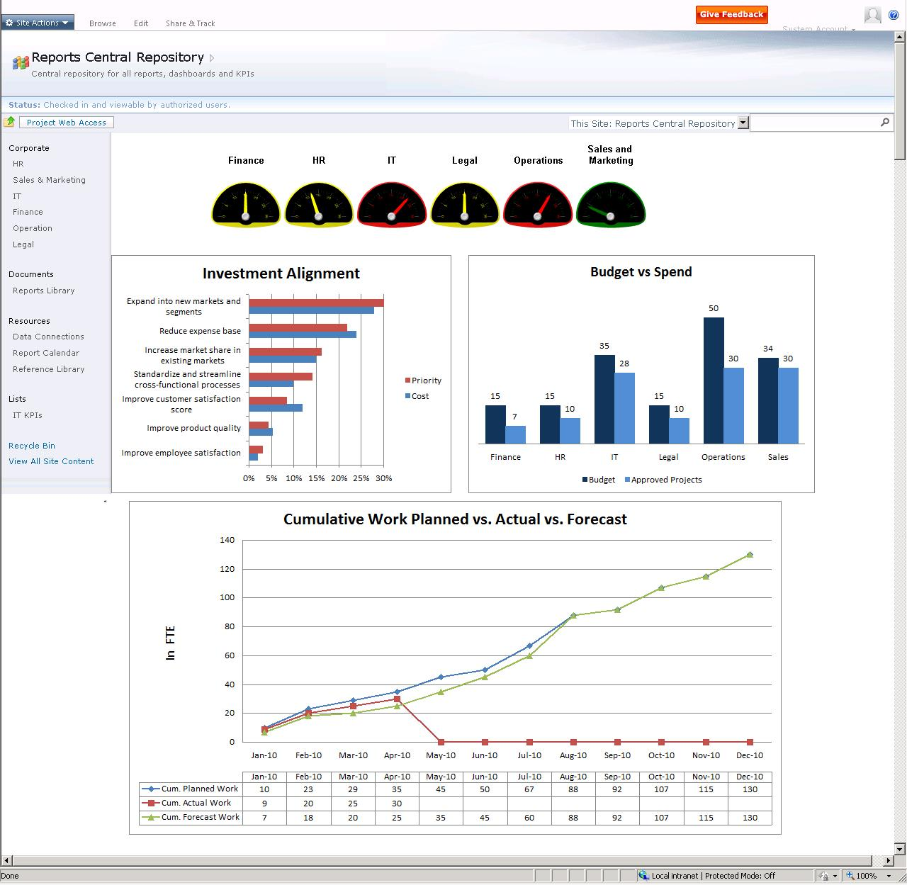
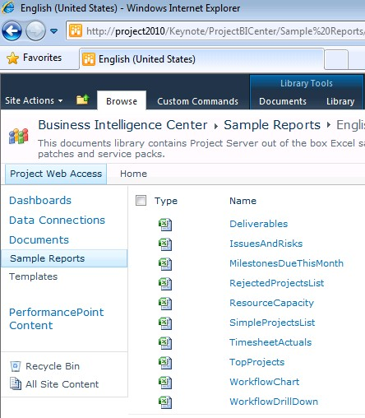
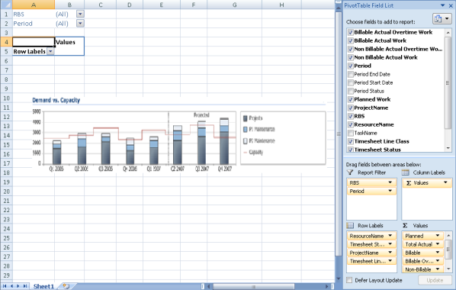
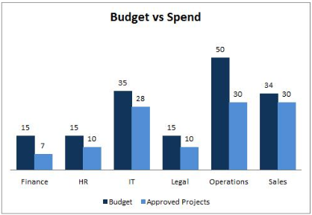
Enhanced Collaboration & Reporting Simply create powerful reports and dashboards
Build Powerful Dashboards
Business Intelligence Center
Quickly create reports from predefined and localized best practice templates
Customize in Excel and render through Excel Services
Create powerful audience based dashboards to monitor portfolio performance
Best Practice Report Templates
Customize in Excel
Excel Services Webparts

Slide 22
Microsoft SharePoint 2010
Ribbon UI
SharePoint Workspace
SharePoint Mobile
Office Client and Office Web App Integration
Standards Support
Business Connectivity Services
InfoPath Form Services
External Lists
Workflow
SharePoint Designer
Visual Studio
API Enhancements
REST/ATOM/RSS
Sites
Tagging, Tag Cloud, Ratings
Social Bookmarking
Blogs and Wikis
My Sites
Activity Feeds
Profiles and Expertise
Org Browser
Composites
Communities
Project Server 2010 is built on SharePoint 2010
-> Explore Coexistence Opportunities
PerformancePoint Services
Excel Services
Chart Web Part
Visio Services
Web Analytics
SQL Server Integration
PowerPivot
Insights
Content
Search
Enterprise Content Types
Metadata and Navigation
Document Sets
Multi-stage Disposition
Audio and Video Content Types
Remote Blob Storage
List Enhancements
Social Relevance
Phonetic Search
Navigation
FAST Integration
Enhanced Pipeline

Slide 23
Enhanced Collaboration and Reporting
demo

Slide 24

Microsoft Project 2010 Scalable and Connected Platform
Extend Interoperability
Simplified Administration
Rich Platform Services
Developer Productivity
Unified Project and Portfolio Management
Simple and Intuitive User Experience
Scalable and Connected Platform
Enhanced Collaboration and Reporting

Slide 25





Scalable and Connected Platform Powerful work management delivered in familiar and connected tools
Project Server Interface
=
EPM SOLUTION
Notes:
Integration with related Microsoft technologies provides a familiar and connected work management platform. Empower teams to work in their preferred productivity tools and provide status updates to project stakeholders with minimal effort and administrative overhead
Exchange Server - Conveniently receive and update your project tasks in Outlook
Visual Studio Team Foundation Server - Seamlessly connect the worlds of application development and project and portfolio management
Dynamics AX & SL - Enhanced financial management and project accounting capabilities through Dynamics AX and SL

Slide 26
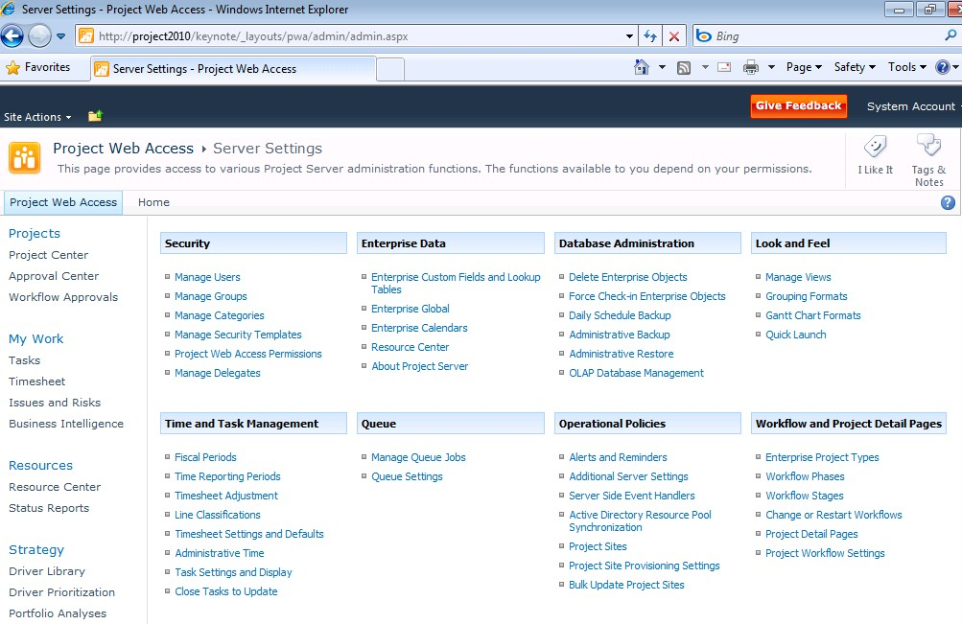
Scalable and Connected Platform Simplified Administration
Centralized administration – One stop console for managing both project and portfolio management capabilities
User Delegation – Easily specify colleagues to act as your delegate when out of the office
Departmental Fields – Provide a level of autonomy while maintaining enterprise standardization and control
Cube Administration – Enhanced administration interface to visualize status and manage cubes

Slide 27
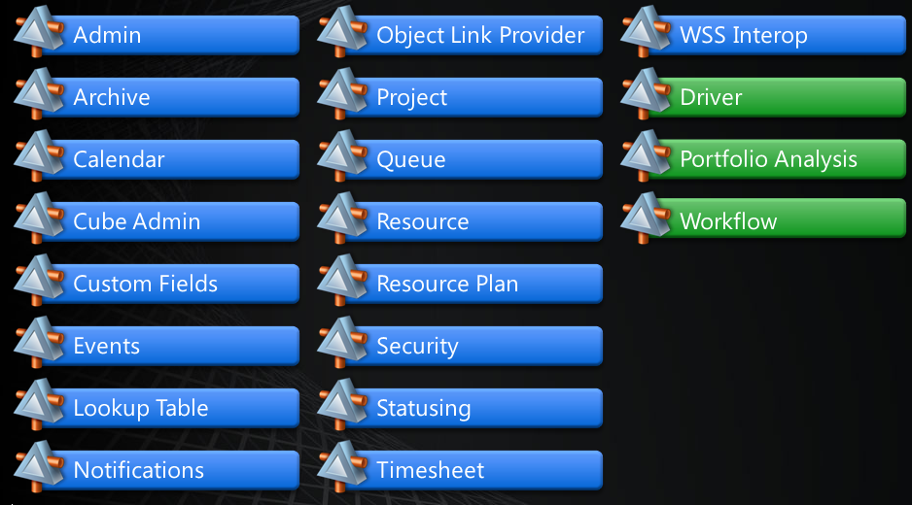
Scalable and Connected Platform Extensible and Scalable Platform
Programmable
Project Server Interface (PSI) 2010 backward compatible with 2007 methods
Enhanced PSI includes project and portfolio capabilities
Deployable
Remove ActiveX® dependency
Scalable
Built on SharePoint 2010
Project Server 2010 64-bit
Project (Std & Prof) 32-bit & 64-bit

Slide 28









Microsoft Project 2010 Product Packaging
Target Audience
Individual and Part-Time Project Managers
Professional Project Managers
IT, PMO, Engineering, R&D, Product Development, Operations

Slide 29



Project 2010 Product SKU’s
Target Audience
Individual and Part-Time Project Managers
Professional Project Managers
CIO, PMO, Operations, R&D, Product Development
Fluent User Interface
User Controlled Scheduling
Timeline View
Project Standard PLUS
Enhanced Scheduling
Team Planner
Project Synch to SharePoint
Web Based Scheduling
Unified Project and Portfolio Management
Enhanced BI and Reporting
Key Changes
CAL
CAL Not Required
Project Server CAL Included
CAL Required
Key Dependencies
SharePoint Server 2010
SharePoint Enterprise CAL
64-bit Windows Server 2008
Windows XP, Vista, or Windows 7
Windows XP, Vista, or Windows 7

Slide 30
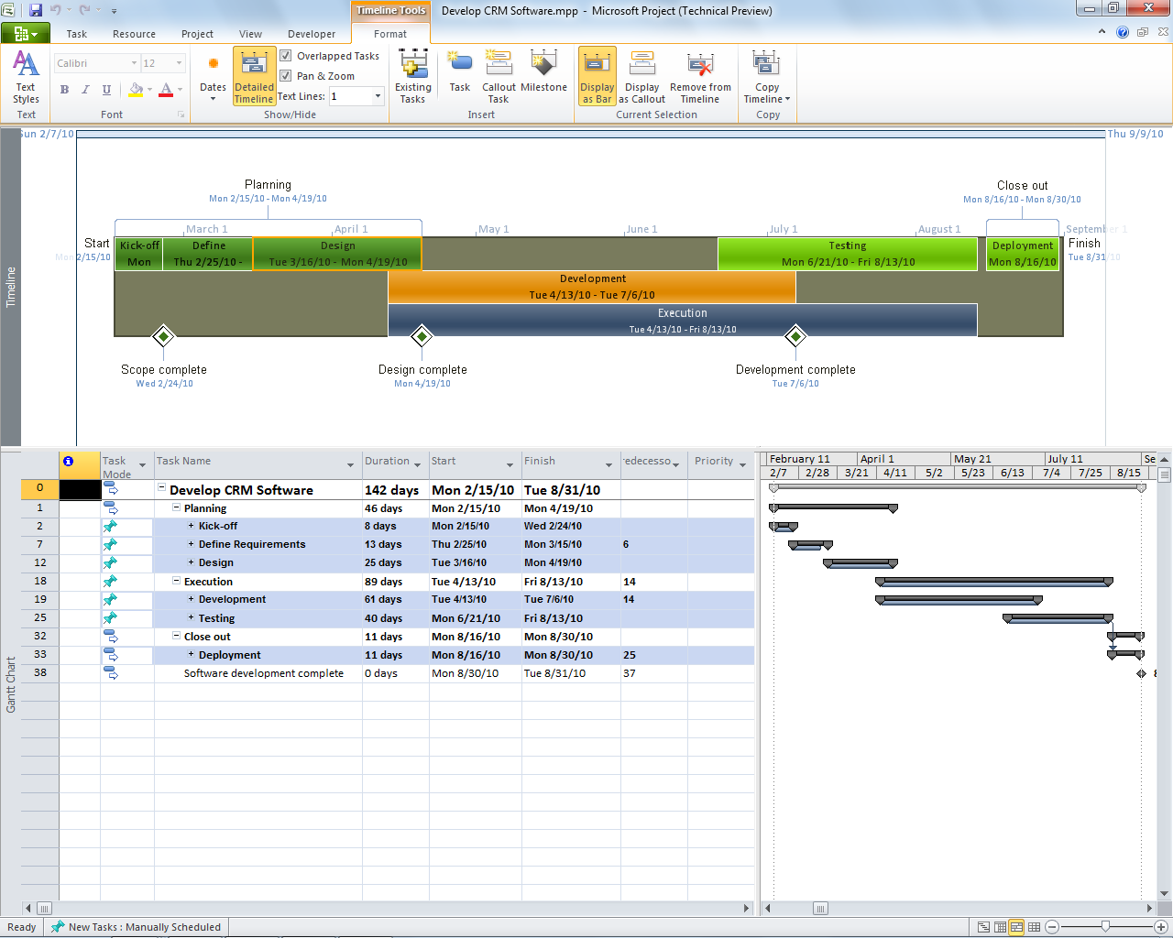
Microsoft Project 2010 Simple and Intuitive User Experience
New User Interface
New User Controlled scheduling
New Intuitive Excel like behavior
New Timeline View
New Team Planner View
Unified Project and Portfolio Management
Simple and Intuitive User Experience
Scalable and Connected Platform
Enhanced Collaboration and Reporting

Slide 31
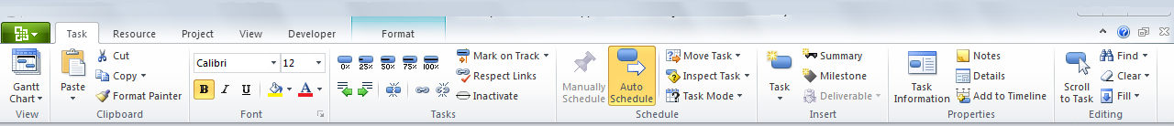
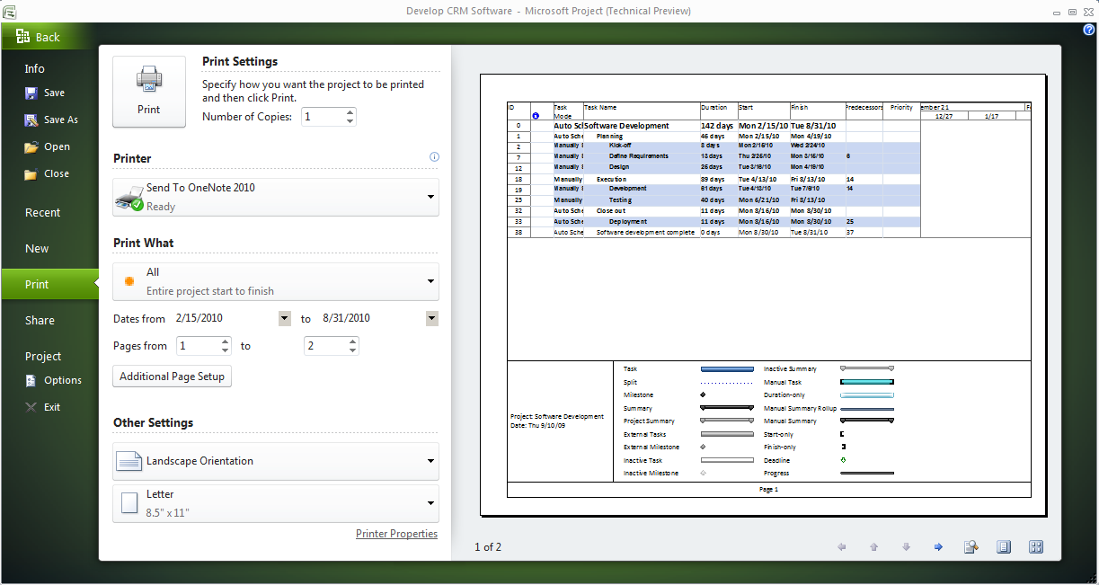
Simple and Intuitive User Experience New User Interface
Experience the full power of Project 2010 with the easy to use Ribbon
Get started quicker with the familiar Fluent User Interface
Enhanced Contextual menus reveal relevant features
Descriptive tooltips
Share, print, and publish project information with just one click in Backstage
Ribbon
Backstage

Slide 32
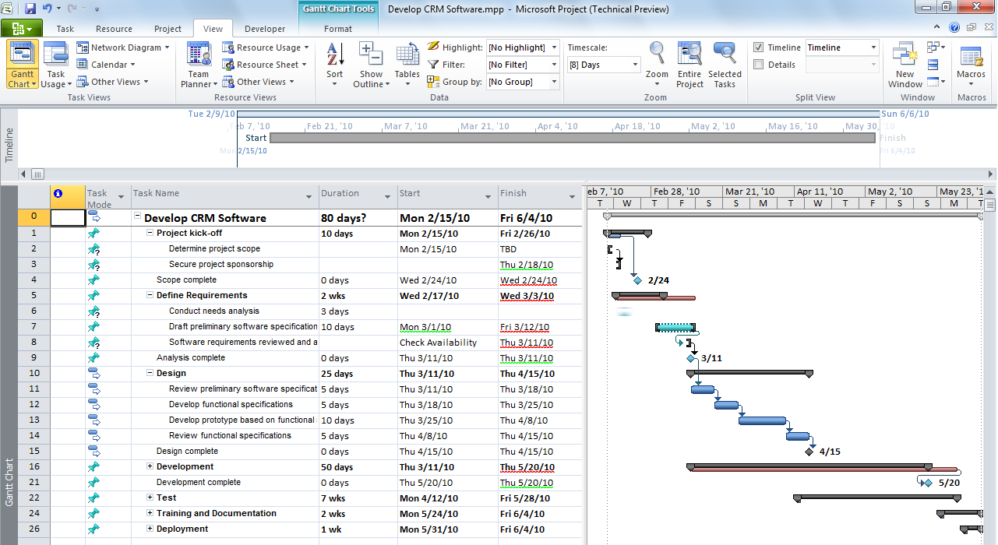
Simple and Intuitive User Experience User Controlled Scheduling
Top Down Planning
Flexible scheduling puts you in control of the plan
Manually Scheduled Tasks
Choose manually scheduled or automatically scheduled tasks
Only enter task data when you have it
Add notes to duration and date fields
Be alerted to scheduling concerns with squiggly lines – then take action in Task Inspectors
Task with End Date Only
Reminder Notes
Scheduling Concerns

Slide 33
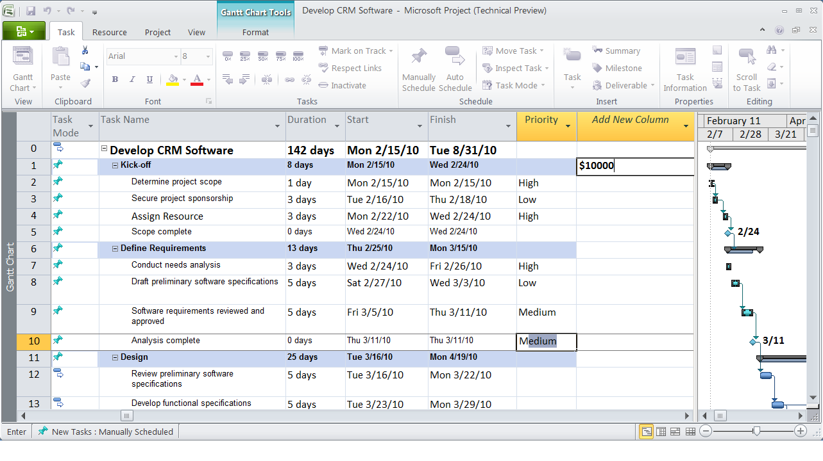
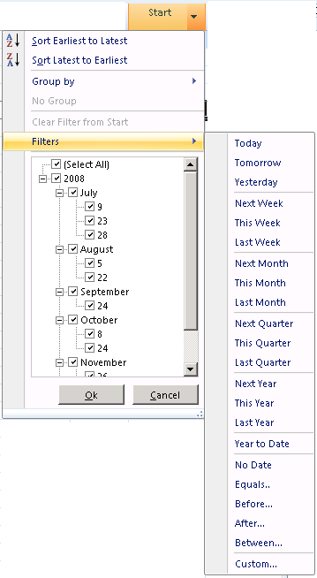
Simple and Intuitive User Experience Intuitive Excel like behavior
Add New Column
Excel like experience enhances productivity
Add New Column: Simply start typing text in a new column and Project will create right custom field and perform data validations
Text Wrapping: Easier to view project data with automatic text wrapping
Auto-Complete: Save time and effort with the new text auto-complete function
Auto-Filter: Grid improvements make it easier to filter, group, sort, and customize your data just like Excel
Auto Complete
Filter, Sort & Group
Text Wrapping

Slide 34
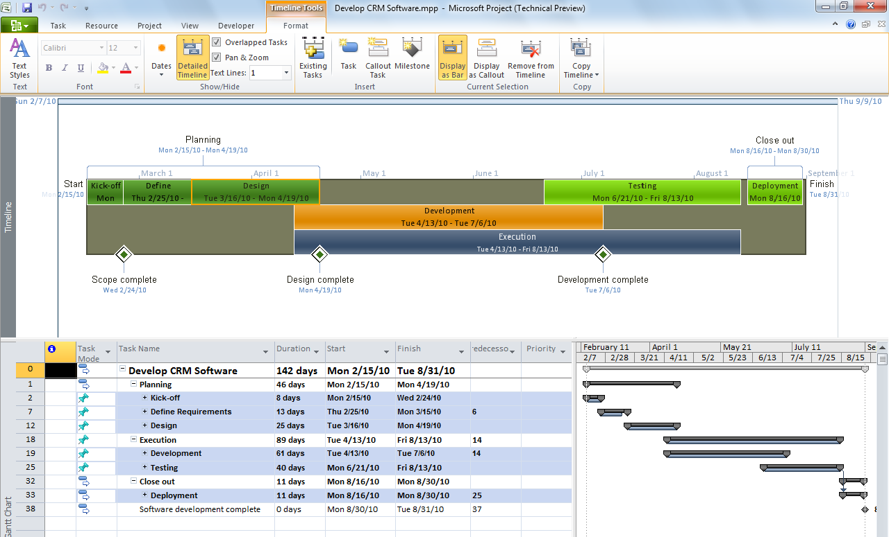
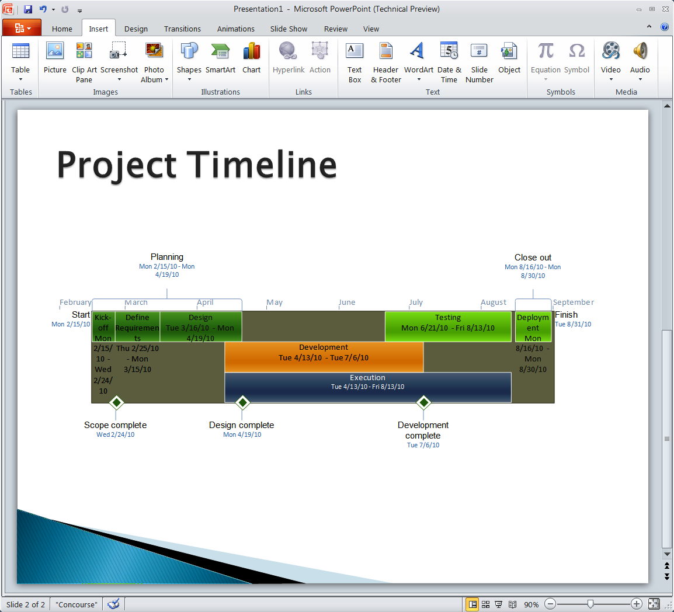
Simple and Intuitive User Experience Timeline View
Timeline View
Enhance communication with the new Timeline View
Intuitively pan and zoom to focus on the right timeframe
Easily select tasks and add to the Timeline View
Format and customize Timeline to highlight key milestones
Share with stakeholders by simply copying into Office tools
Timeline in PowerPoint
Select Tasks to Display on Timeline

Slide 35
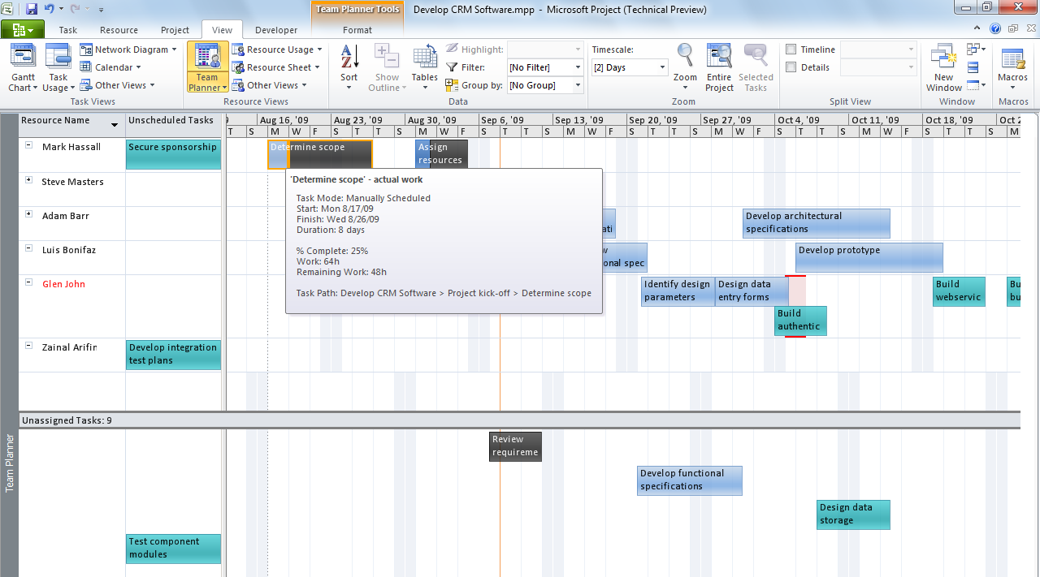
Simple and Intuitive User Experience Team Planner View
Task Status Info
Effectively manage resources with Project Professional’s Team Planner
Visually manage assignments in an intuitive resource centric view
Conveniently drag and drop tasks to assign to resources
Easily transfer tasks between resources
Quickly identify over allocated resources and take action
Simply hover over tasks to see status information
Unassigned Tasks
Assigned Tasks
Resources

Slide 36
Microsoft Project 2010 Enhanced Collaboration and Reporting
New - Connect teams with SharePoint Sync
Enhanced Visual Reports
Unified Project and Portfolio Management
Simple and Intuitive User Experience
Scalable and Connected Platform
Enhanced Collaboration and Reporting

Slide 37
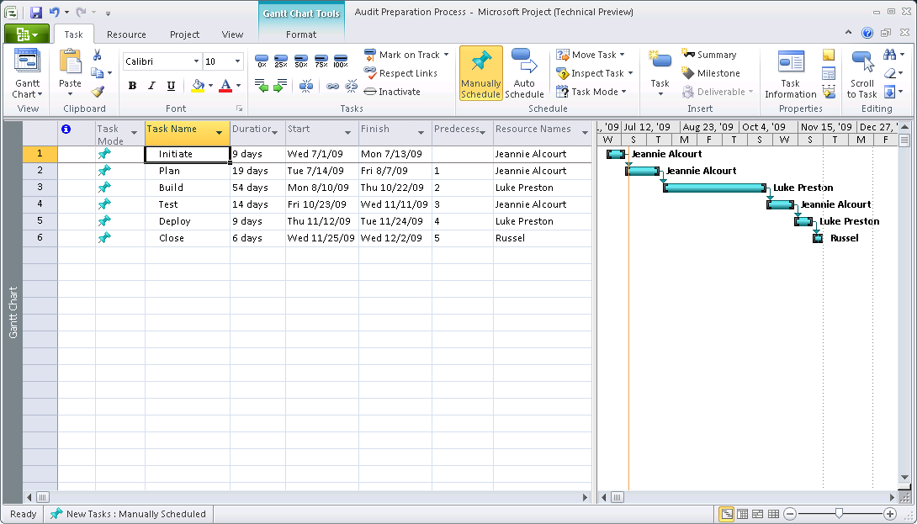
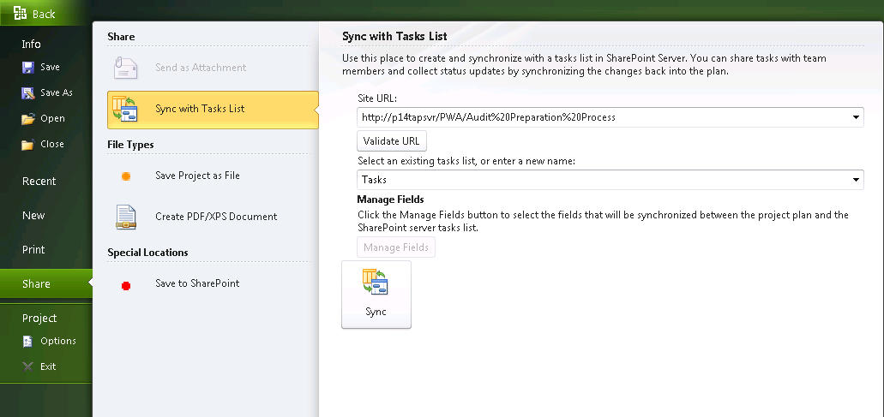
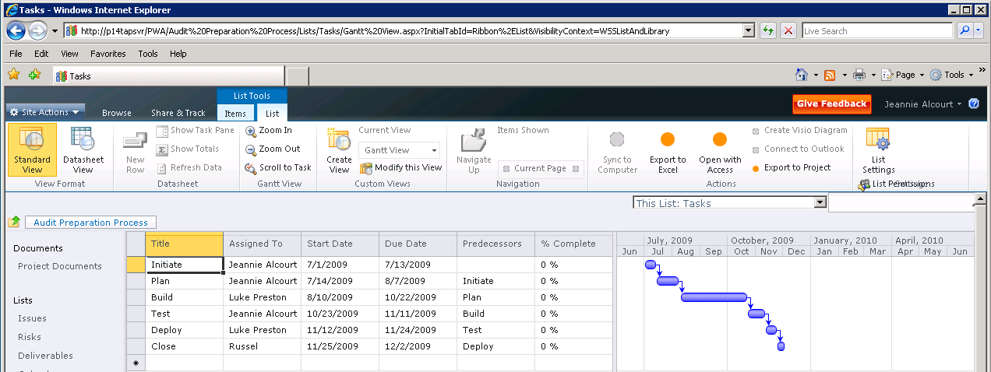
Enhanced Collaboration and Reporting Synchronize with SharePoint tasks
Project Professional 2010
Elevate your SharePoint tasks to real projects and effectively share your Project plans using SharePoint
Share project tasks in SharePoint
Accept updates from SharePoint tasks list
Mange conflicts
SharePoint 2010

Slide 38
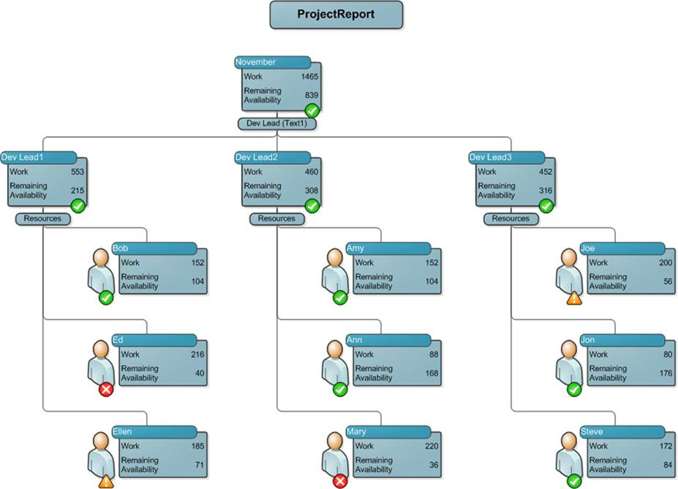
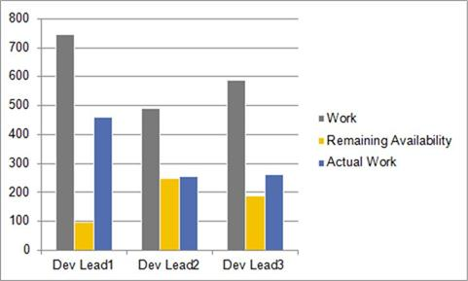
Enhanced Collaboration and Reporting Visual Reports Improvements
Use familiar tools like Excel and Visio to produce rich and impacting Visual reports
Support for assignment custom fields
Longer field names

Slide 39
Project 2010 desktop
demo

Slide 40
Microsoft Project 2010 Scalable and Connected Platform
Extensibility
New - Backwards Compatibility Mode
Unified Project and Portfolio Management
Simple and Intuitive User Experience
Scalable and Connected Platform
Enhanced Collaboration and Reporting

Slide 41
Scalable and Connected Platform Client extensibility – WITHOUT code
“Custom Fields”
Custom metadata associated with tasks, resources, assignments and (projects)
Could have an icon representation and formulas
Views Modification
Adding columns, custom grouping and filtering, e.g. based on the Custom Fields
Custom Visual Reports
Manage your custom templates for Excel and Visio – based reporting

Slide 42
Scalable and Connected Platform Client extensibility – WITH code
Client Object Model (OM)
Rich customizations and add-ons leveraging Project functionality including scheduling
Visual Basic for Applications (VBA) or Visual Studio Tools for Office (VSTO) could be used
User Interface (UI) modifications
Ribbon
Backstage

Slide 43






Scalable and Connected Platform Backwards Compatibility Mode
Accelerate deployment of Project 2010
Seamless co-existence and data exchange among various Project client versions
Both Project 2010 desktop and Project Server 2010 scenario
Project Server 2010
in “Compatibility Mode”
Project MPP file
Project 2010
Project 2007
Project 2003
Project
Professional 2010
Project
Professional 2007

Slide 44
Additional Resources
http://blogs.msdn.com/project

Slide 45
Questions?

Slide 46

© 2009 Microsoft Corporation. All rights reserved. Microsoft, Windows, Windows Vista and other product names are or may be registered trademarks and/or trademarks in the U.S. and/or other countries.
The information herein is for informational purposes only and represents the current view of Microsoft Corporation as of the date of this presentation. Because Microsoft must respond to changing market conditions, it should not be interpreted to be a commitment on the part of Microsoft, and Microsoft cannot guarantee the accuracy of any information provided after the date of this presentation. MICROSOFT MAKES NO WARRANTIES, EXPRESS, IMPLIED OR STATUTORY, AS TO THE INFORMATION IN THIS PRESENTATION.

Slide 47

SharePoint Sites
Easy site editing, including theming & branding
Office Ribbon UI for faster training & adoption
Rich offline experience with SharePoint Workspace
Rich User Experience
Anywhere Access
Mobile-based interaction with people and content
Read-write web access using Office Web Application
Cross-browser support for maximized participation
Single Platform
Collaboration across Intranet, Extranet & Internet
Improved interoperability with standards support
Out-of-box accessibility compliance for WCAG 2.0

Slide 48
SharePoint Communities
Informal Knowledge
Promote sharing with easy social authoring
Easily navigate resources with pervasive tagging
Find better answers faster via user feedback
Social Connections
Connecting users through enhanced profiles
Staying up-to-date using news feeds and alerts
Make expertise discovery easy across the enterprise
Participation Anywhere
Work with peers whether online or offline
Collaborate on the go through the mobile UI
Enrich existing applications with social context

Slide 49
SharePoint Content
User-centric
Intuitive interaction with content through Office
Fast discovery using content metadata and tagging
Rapid creation and publishing of web content
Flexibility and Compliance
Pervasive records management and legal holds
Enterprise-wide taxonomies and folksonomies
Cross-farm policies and rules for all content types
Management Efficiency
Metadata and tagging managed by same services
Less storage and bandwidth for Office & binary content
Interoperability framework to link legacy repositories

Slide 50
SharePoint Search
Better Answers, Faster
Improved relevance based on usage and history
Rich results-navigators for shorter search time
Support for 400+ content types and 85 languages
Phonetic and multi-lingual for global relevance
Social connections driven by interests and expertise
Secure access to content, whether internal or external
Knowledge Amplification
Enterprise Deployment
Improved scale to meet any demand volume
Deployment-specific tuning for best results
Search-driven applications to enrich platform

Slide 51
SharePoint Insights
Data interaction
Advanced analysis with Excel Services
Richer data visualization and easy sharing
Incorporation of LOB data in data analysis
Powerful Self-Service capabilities and visualizations
Compelling dashboards to drive business results
Rich reports with access to millions of rows
Decision Making
Organizational Effectiveness
Drive accountability and alignment with scorecards
Identify issues and opportunities with real-time access
Improved API for richer extensibility and development

Slide 52
SharePoint Composites
Enhanced toolset for end-user solutions
Process automation and data validation with Forms
Visio services integration for data visualization
User-Driven Solutions
Data Connectivity
Business Connectivity Services for LOB data exchange
LOB data in Outlook, Word & Workspace without code
SharePoint data exposed through web services & APIs
Solution Deployment
Sandboxed Solutions for self-service and fast installation
Platform stability with resource quota-management
Standards support for integration and accessibility

Slide 53

IT Pro Investments
Terabytes of data and multi-million item lists
Improved Platform resiliency and redundancy
Advanced back-up, restore and disaster recovery
Scale with Governance
Deployment Flexibility
Collaboration across Intranet, Extranet and Internet
On-premise and/or hosted options
Data storage inside and outside the SharePoint DB
IT Productivity
Enterprise-wide management capabilities
Robust installation and predictable upgrade process
Higher availability with better patch management

Slide 54
Developer Investments
Developer Productivity
Rapidly develop solutions with Visual Studio 2010
Application Lifecycle Management & Team Dev
Solution quality improved with debugging tools
Deployment Platform
Rich solution UI with Silverlight, XSLT View, Clean HTML
Data Foundation – Relationships, Lookup
Better programmability with LINQ, Client API
Solution Hosting
Standardized WSP Package Deployment
SharePoint Online shared solution hosting
Install on Vista SP1 or Windows 7 for Developers only

Slide 55
Microsoft SharePoint 2010 The Business Collaboration Platform for the Enterprise and the Web
Sites
Composites
Communities
Connect and Empower People
Cut Costs with a Unified Infrastructure
Rapidly Respond to Business Needs
Insights
Content
Search

Slide 56
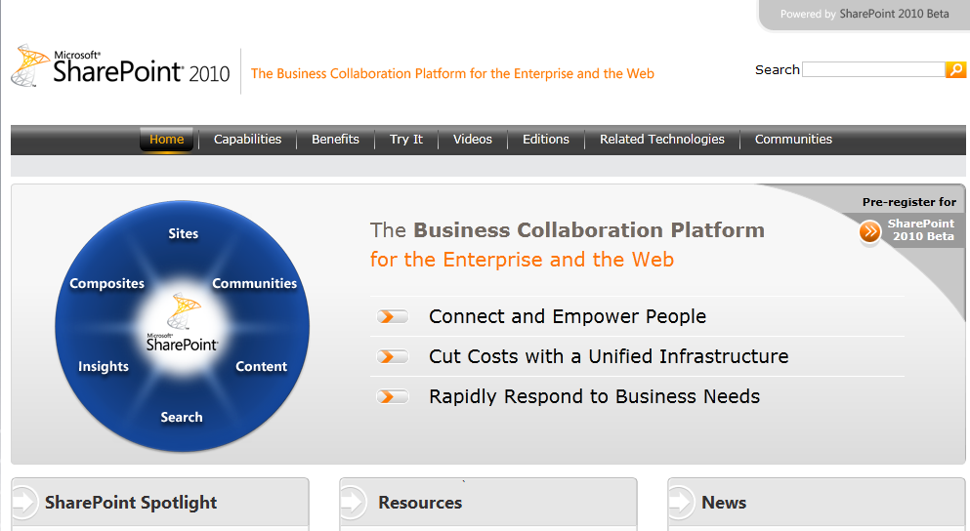
SharePoint 2010 Resources
http://sharepoint2010.microsoft.com/Pages/default.aspx
http://technet.microsoft.com/en-us/sharepoint/ee263917.aspx
http://msdn.microsoft.com/en-us/sharepoint/ee514561.aspx

